Slide 1

P3 –P4 英文溫習技巧

Slide 2
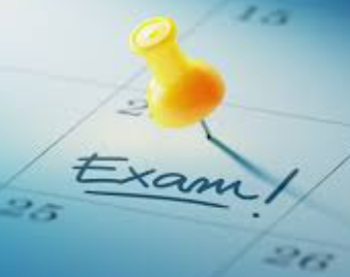
GE I
Reading
Grammar
Writing
GE II
Listening
Speaking
* Dictation Exam

Slide 3
G.E. I: Book 3A Ch 1 (P.7-13)
Book 3A Ch 3 (P.19-23)
Vocab Book P.66
All Booklets
– (P3) RSW
(P4) RSW + Process Writing
JS ( JumpStart)
+ prior knowledge
須參看考試範圍

Slide 4

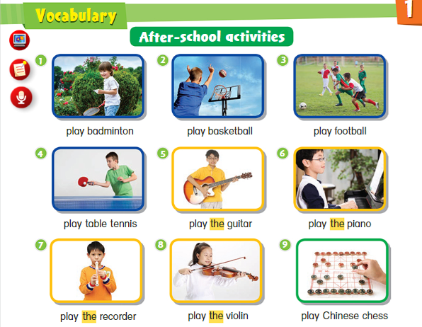
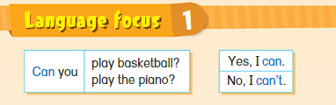
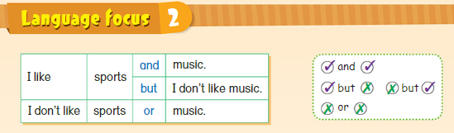
4
Revise Vocabulary + Language Focus 1 + Language Focus 2

Slide 5
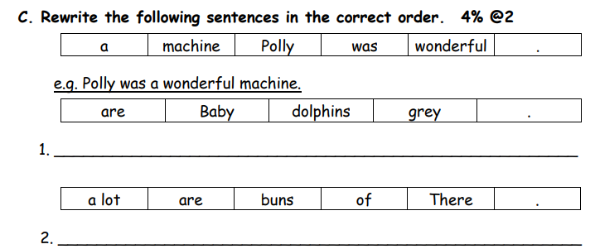
Grammar:
P.3 + P.4 須溫習 Textbook

Slide 6
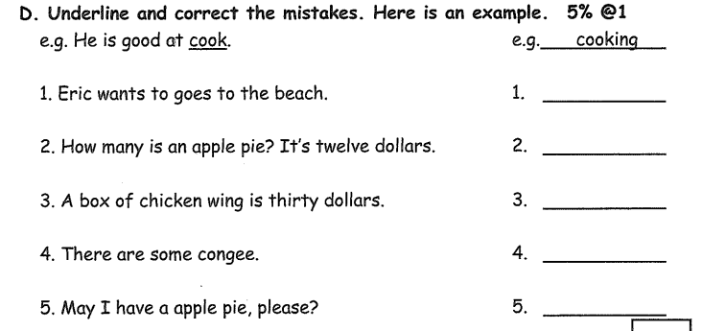
Proofreading 通常有關課文重點，學生重溫WB、GR，觀察老師的批改。
P.3
go
much
wings
is

Slide 7
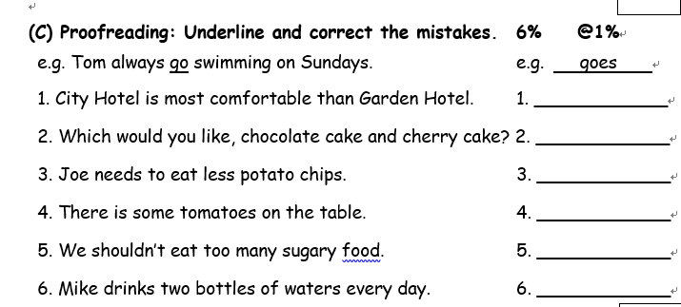
P.4
more

Slide 8
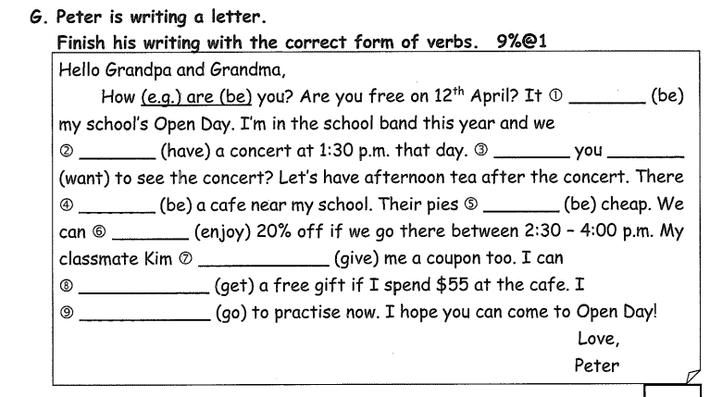
Tenses
P.3:
past tense(下學期)
Present tense
(包括 be, does/do)
Present continuous
To-infinitive
Can + infinitive
is
have
Do want
is
are
enjoy

Slide 9
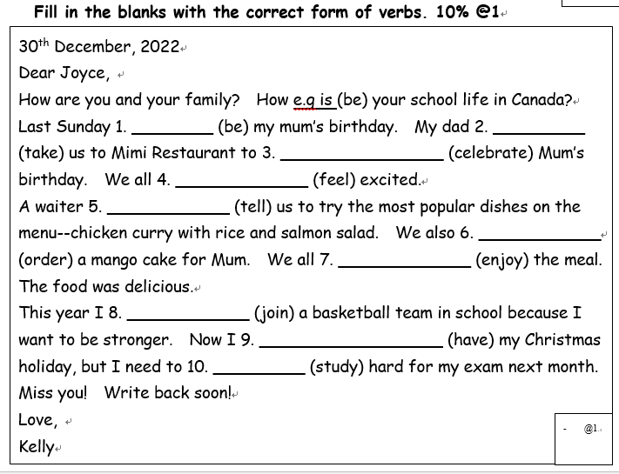
P.4:
past tense
Future tense
Present tense
To-infinitive
Present continuous
Like + ing

Slide 10
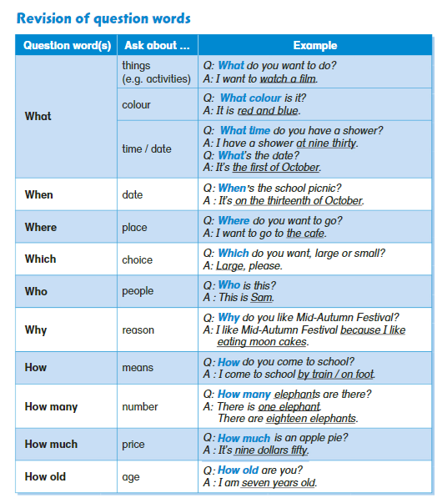
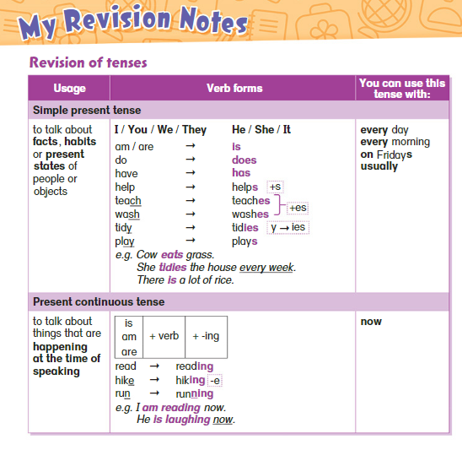
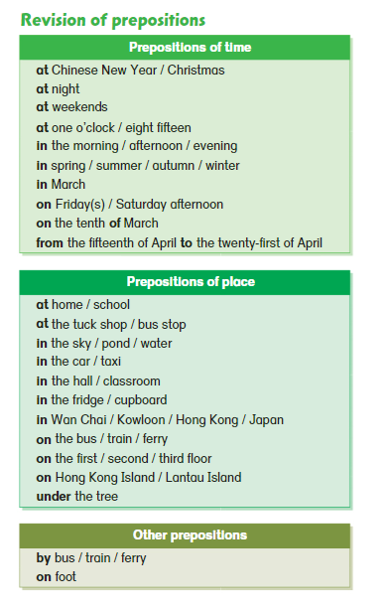
10
Revise Grammar items (in the textbook) such as …

Slide 11
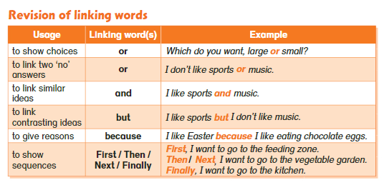
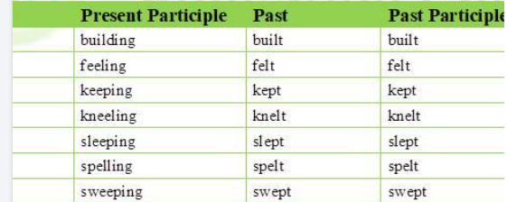
11
Revise Grammar items (in the textbook) such as …
**Verb Table**

Slide 12


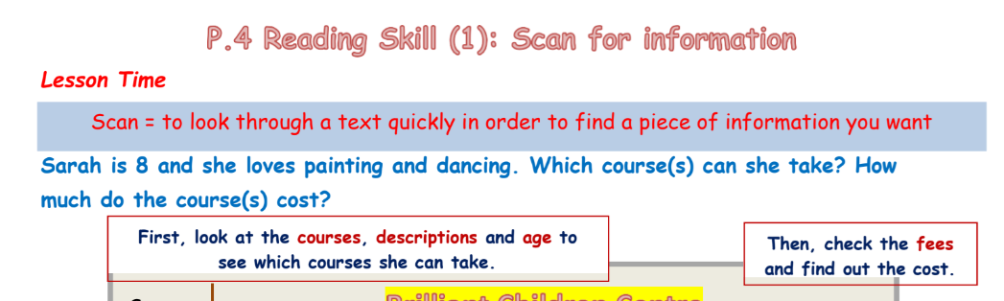
12
Learn Reading skills from RSW + JS (P2-4)

Slide 13
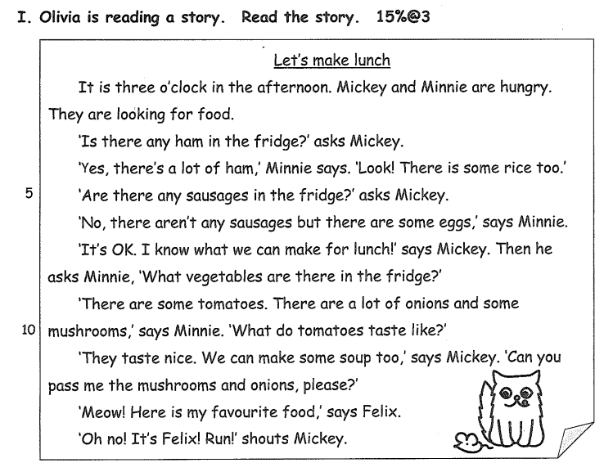
P.3
不宜慢慢數行
可用筆間下重點
先看問題，
再看文章

Slide 14
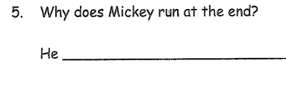
P.3
長答 (answer in complete sentences)：
一定要試做
sees a cat (Felix)

Slide 15
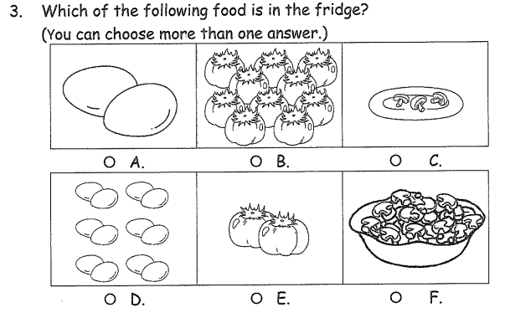
一定會多於一個答案!

Slide 16
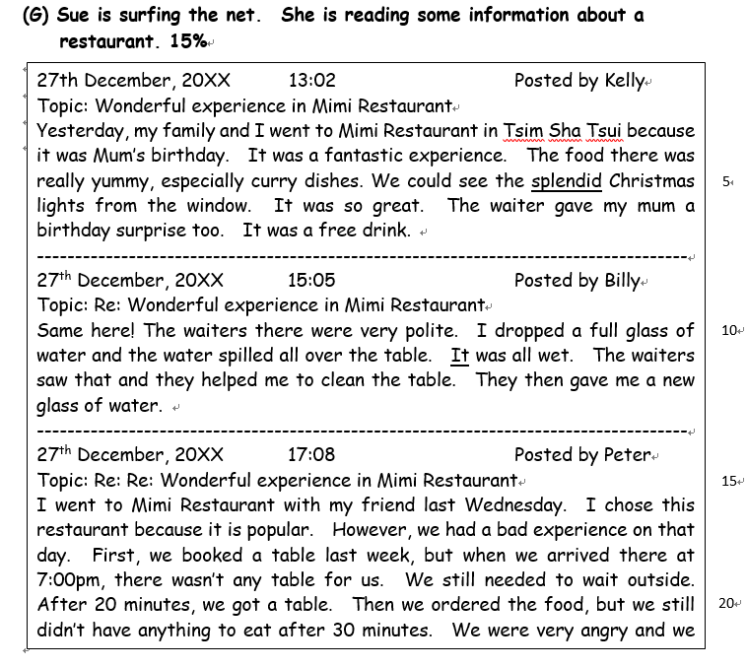
1. What is Sue reading?
○ A. a leaflet
○ B. a story
○ C. an online forum
○ D. an article

Slide 17
不要怕深字!
3. Read line 5. What does ‘splendid’ mean?
○ A. delicious
○ B. beautiful
○ C. relaxing
○ D. comfortable

Slide 18
這類題目會花最多時間 (KS2)
5. Which of the following sentences is NOT true?
○ A. Mimi Restaurant is in Kowloon. ○B. Kelly enjoyed the curry dishes in Mimi Restaurant.
○ C. Billy thinks the waiters were friendly.
○ D. Peter chose Mimi Restaurant because it was his birthday.

Slide 19
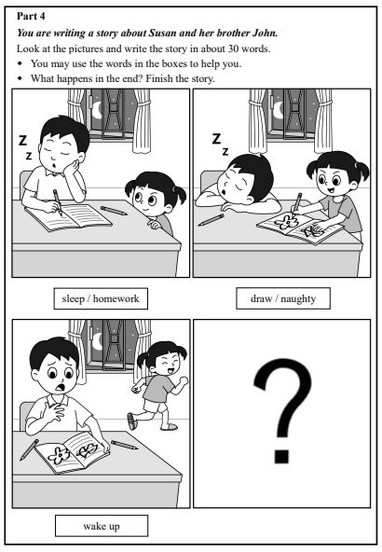
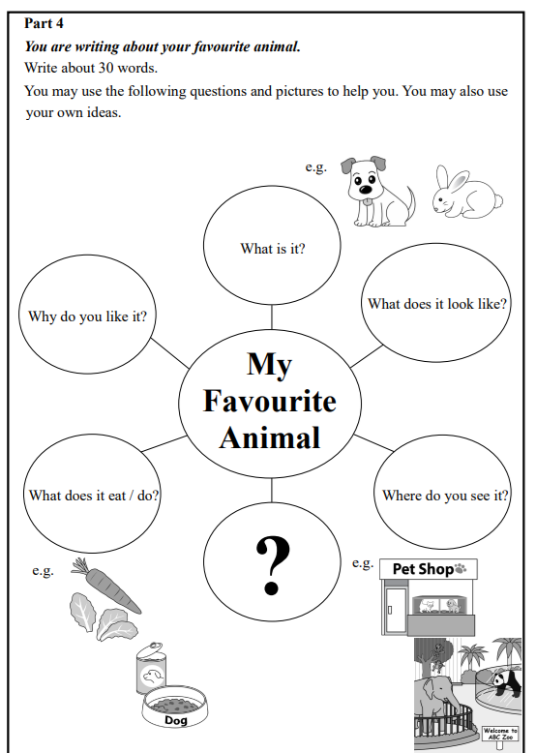
19
Writing : with pictures/ with mind-map /key sentence structures

Slide 20
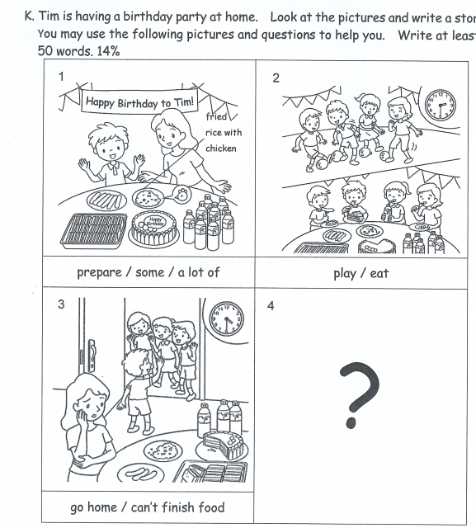
Writing：P.3
三年級開始須分段
。
忌用run-on sentence，如:
Today Tim had a party at home, he prepared a lot of food, there was a big cake.

Slide 21
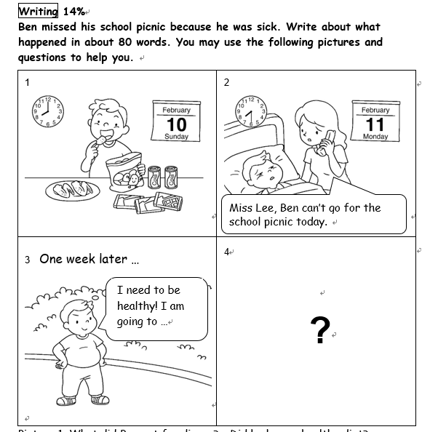
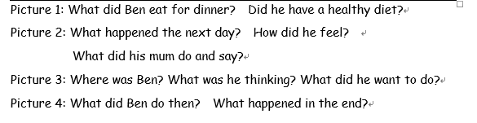
Writing：P.4
圈下題目關鍵詞:

Slide 22
Writing：P.4
KS2 學生應可用Past tense
留意圖畫細節
在考試前預備一些連接詞及佳詞，如:
but/ because / suddenly/ in the end
Thrilled/ disappointed/ frustrated

Slide 23
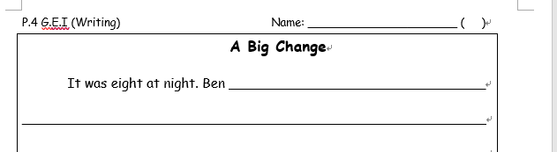
Writing：P.4
留意用第一身還是第三身視角

Slide 24
Writing：P.4
結尾要至少20字/用一段。
L
O
A
F
esson : 他學到甚麼?
He learnt that he should not eat so much snacks.
pinion : 他認為?
He thought he was foolish last time.
ction : 他會(做)?
He will have a healthy diet.
eel : 他覺得?
He felt proud of himself.

Slide 25
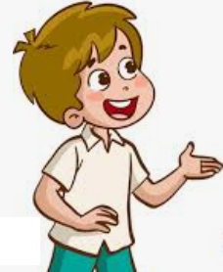
25
Speaking
Read a passage
Greetings
P1-3 : Picture Description
P4-6 : T-S interaction / Presentation
Tackling new words
Phonics + self-confidence can help

Slide 26
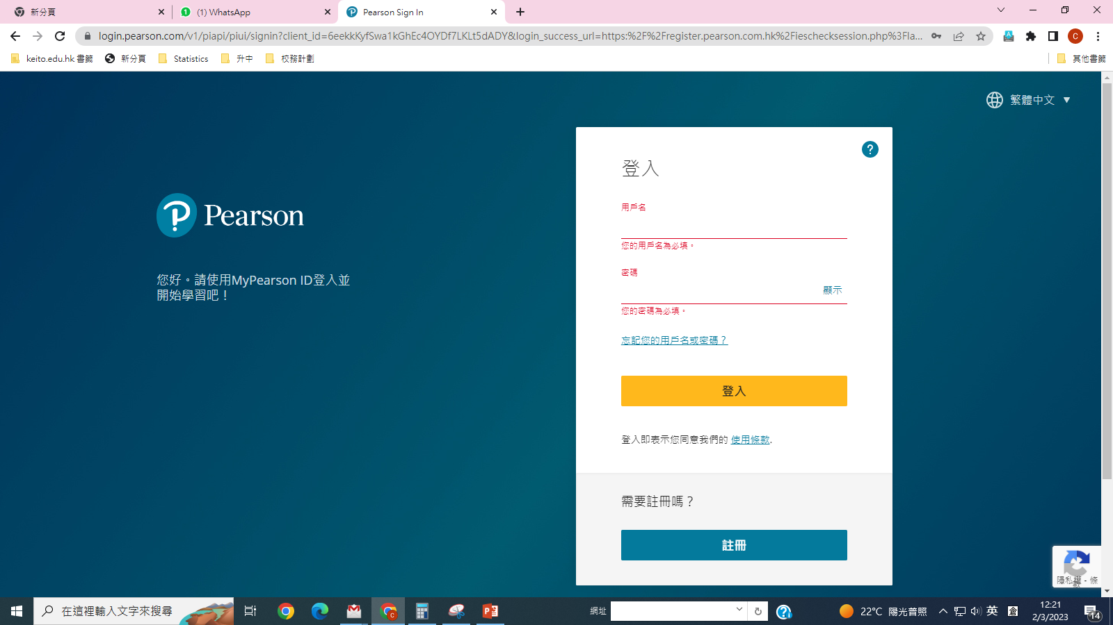
電子課本-免費版
Wkt-XXXXX
參看手冊

Slide 27
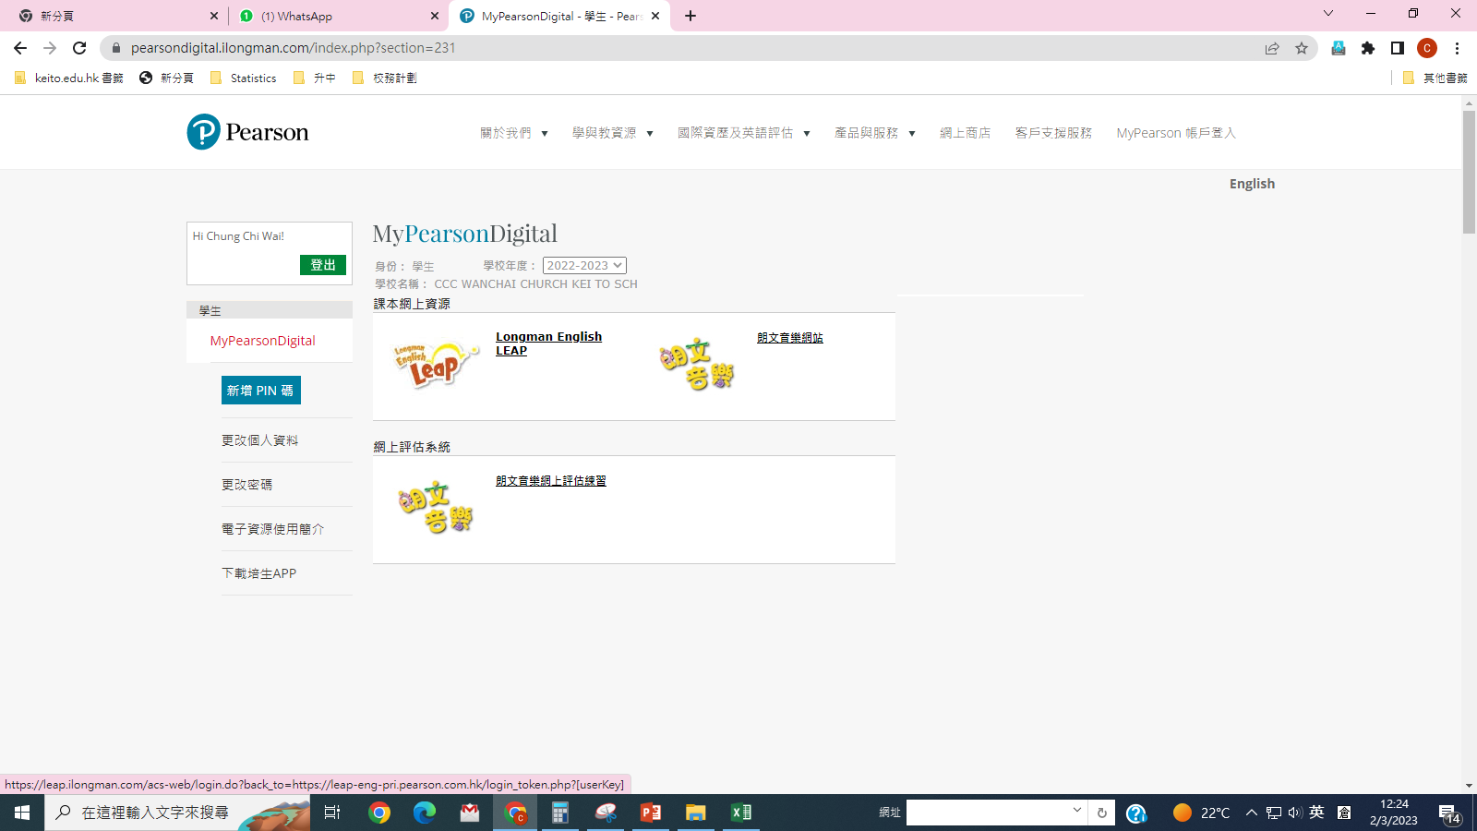

Slide 28
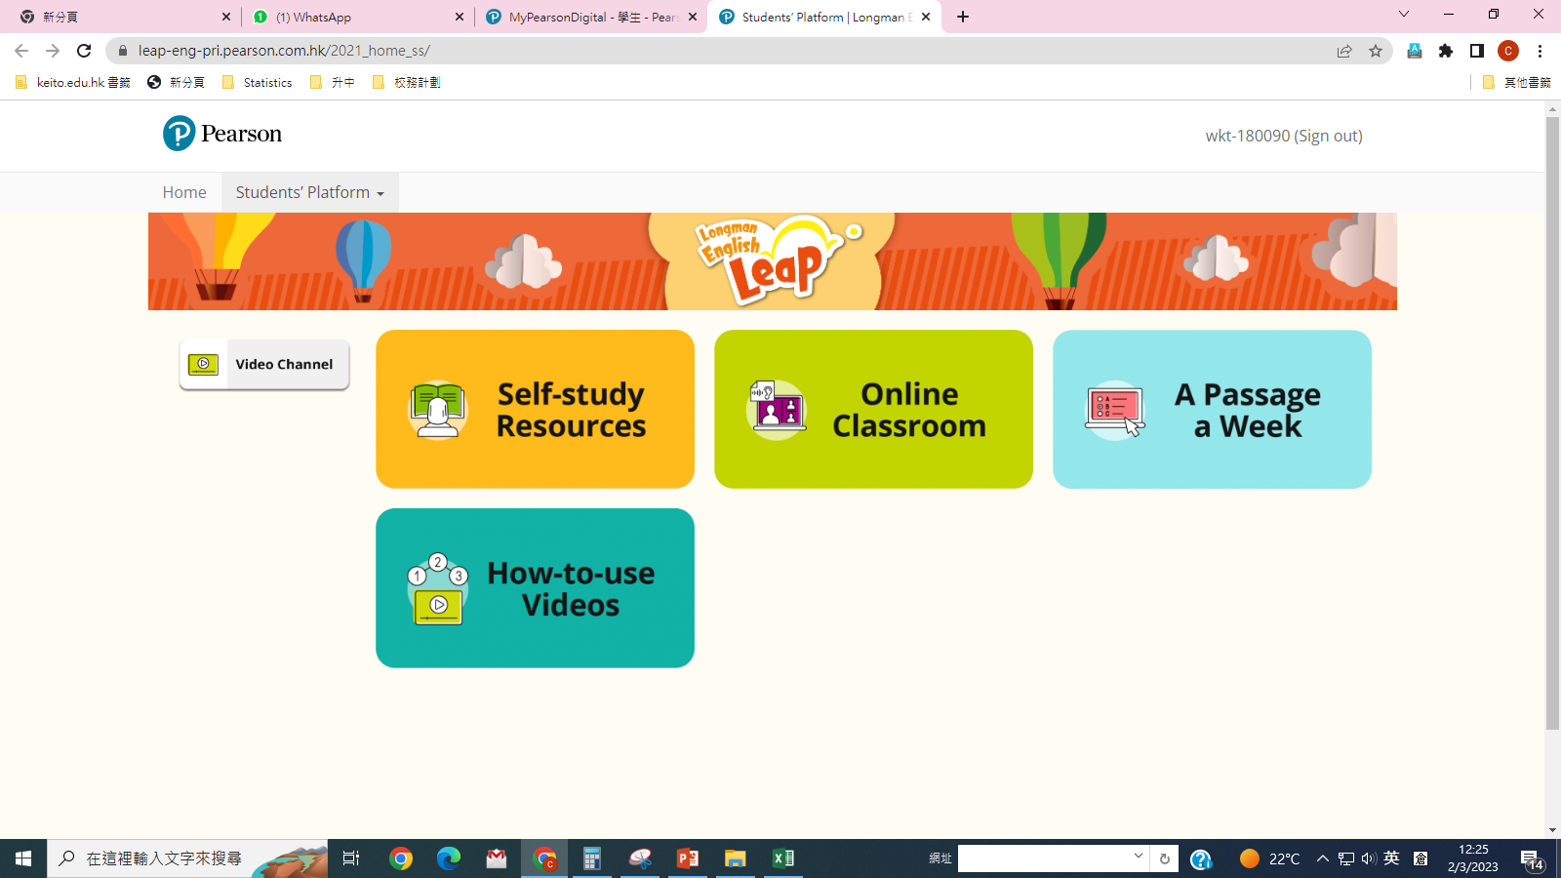

Slide 29
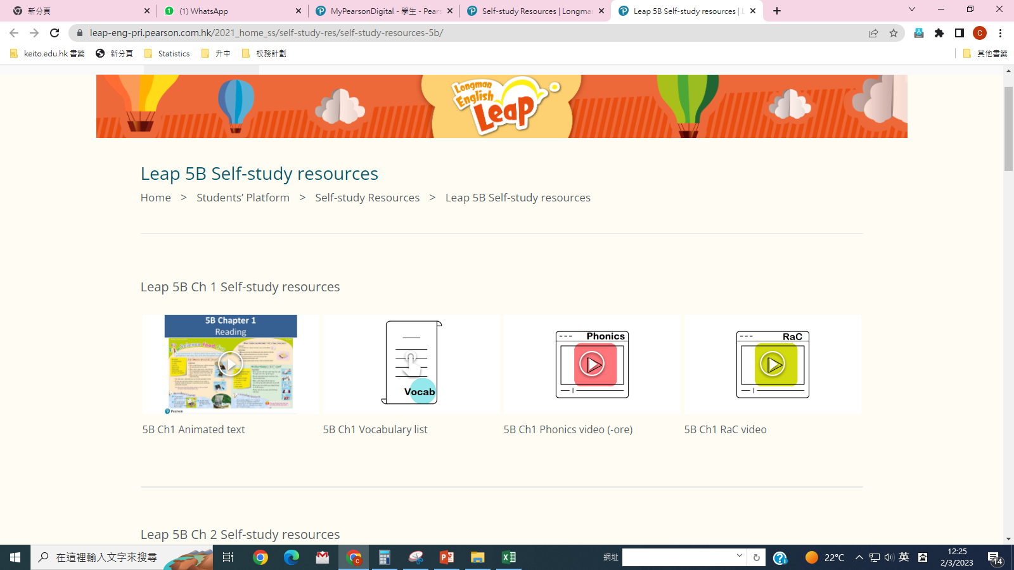

Slide 30
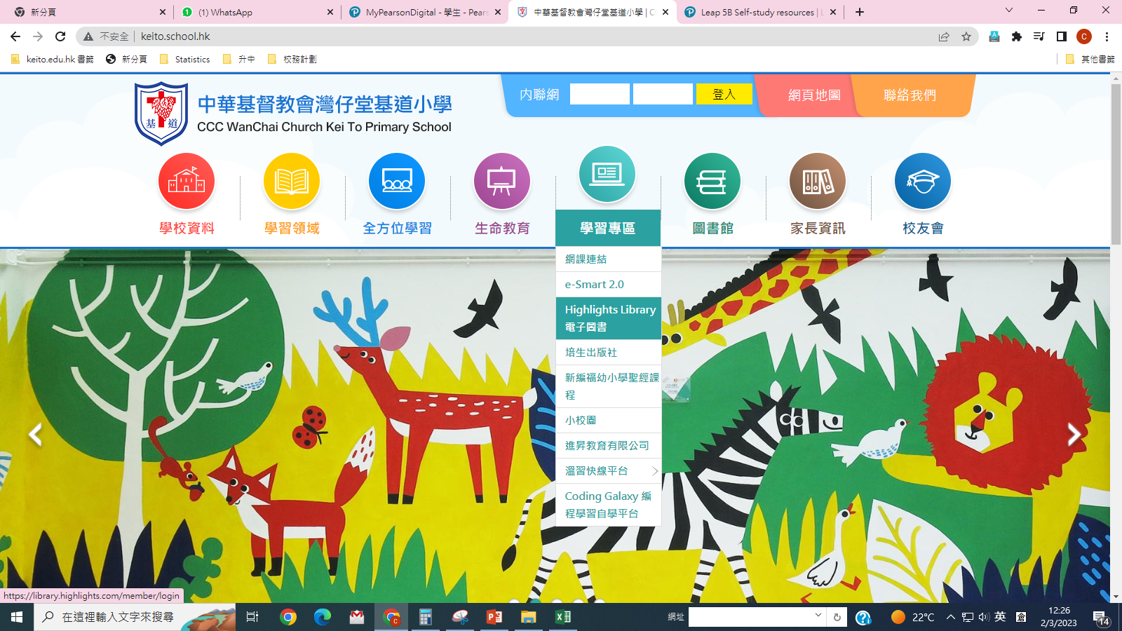
電子圖書

Slide 31
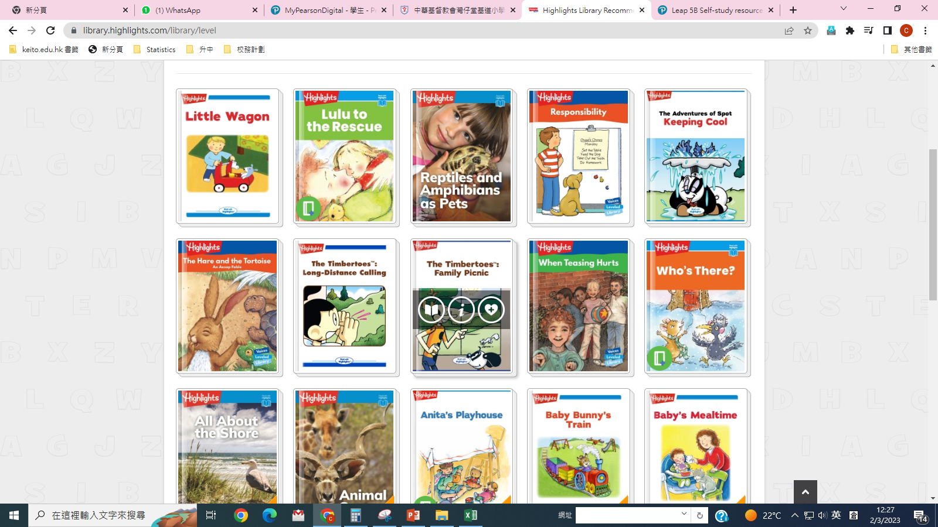

Slide 32
從多閱讀學到：
讀得快
詞匯>> 作文
同一個字在不同的語境的用法
邏輯
認識世界

Slide 33


